Slide 1
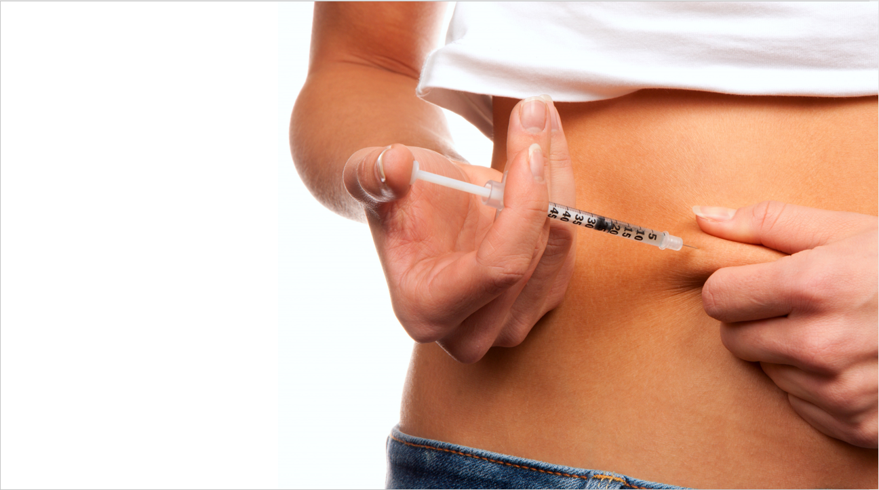
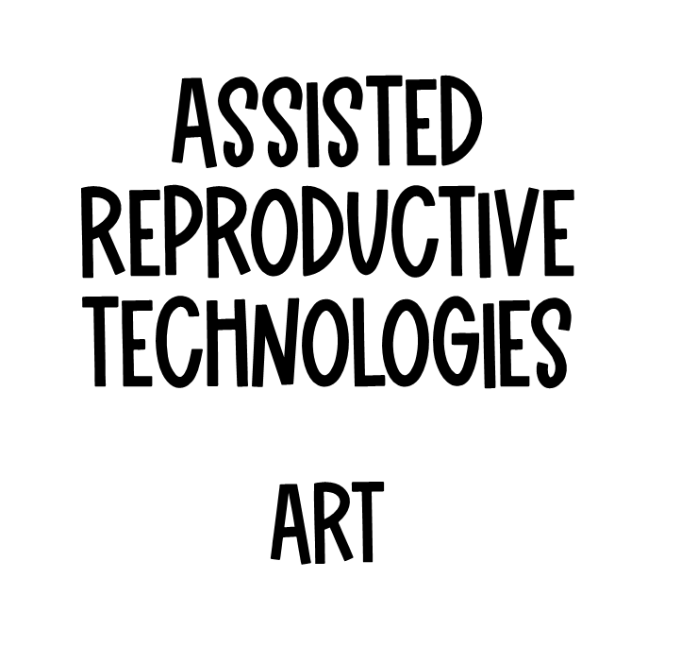

Slide 2

Understand the purpose and processes of the three different types of Assisted Reproductive Technologies,
* In-Vitro Fertilisation,
* Intra-Uterine Insemination and * Embryo Transfer

Slide 3

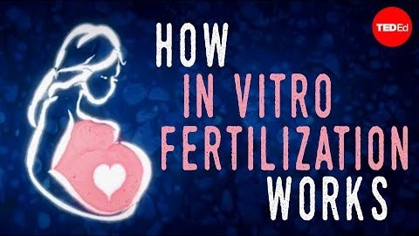





Read
View
Notes
To Do
Stop at 3.30
Next

Slide 4

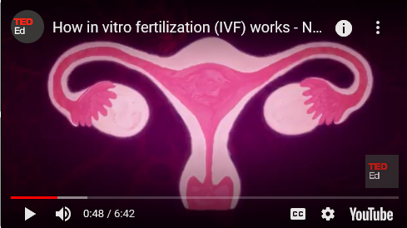



1. What is the purpose of the FSH hormone?
Prepares the uterus for a fertilised egg
Ripens a few follicles in the ovaries
To release the egg from the ovary
Start menstruation.
Read
View
Notes
2. How many follicles become fully mature in a normal monthly cycle?
One
Two
Three
More than three.
3. Which hormone is necessary to then maintain a pregnancy?
Oestrogen
Progesterone
FSH
LH
To Do

Slide 5

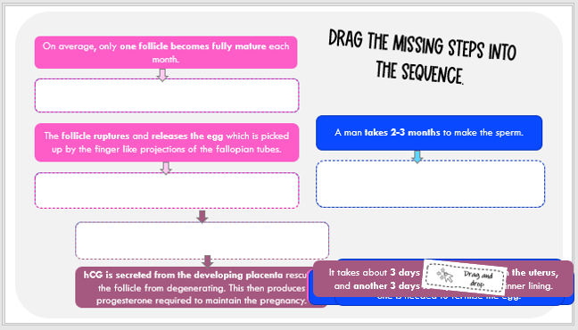

Read
View
Notes
To Do

Slide 6
The follicle makes oestrogen, which when in high enough levels, the brain releases LH, which triggers ovulation. .
(Answers)
Each ejaculation releases more than 100 million sperm, but only 100 make it to the egg, and only one is needed to fertilise the egg.
The egg must be fertilised by sperm within 24 hours of ovulation.
It takes about 3 days for the egg to reach the uterus, and another 3 days to implant into the inner lining.

Slide 7





Read
15% of Australian couples will have infertility problems.
(May 2018, Health Direct)
View
Notes
To Do
The inability to conceive or sustain a pregnancy.

Slide 8



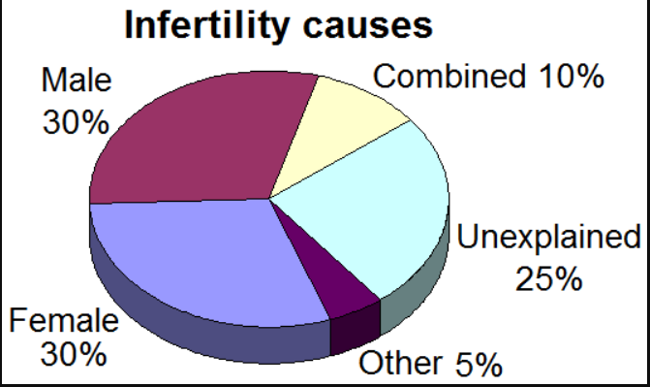
Read
Main factors affecting infertility for a woman…
Ovulatory (eg when a woman does not release an egg every month; poor egg quality)
Tubal - tubal blockage (eg STI’s / Pelvic Endometriosis)
Age
Main factors affecting infertility for a male…
Semen:
volume concentration,
motility,
morphology
View
Notes
To Do

Slide 9

Female and male fertility decrease with age.
For women fertility starts to slowly decline when they are in their early thirties. Around age 35 the decline speeds up and by age 40 the chance of conceiving has fallen by half. The biological reason for this is that….
As women age, the total number of eggs in their ovaries and their quality decline.
The average age of menopause is about 51 years (and this has not changed over the centuries) and this marks the absolute end of fertility
It is rare for a woman to conceive in the 10 years leading up to menopause.
At age 40 about 75% of eggs are chromosomally abnormal which reduces the chance of pregnancy and increases the risk of miscarriage
Read
View
Notes
To Do

Slide 10

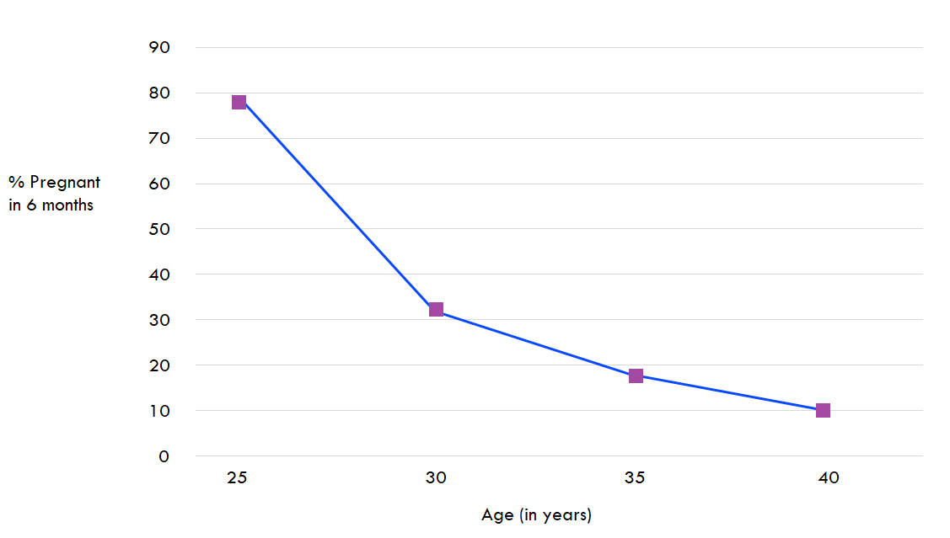
Read
Fertility decreases with age.
View
Notes
To Do

Slide 11

Using the information in the graph, explain how age affects the percentage of women who are able to fall pregnant within the first 6 months of trying.
Read
Fertility decreases with age.
View
At 25 years of age, approximately 70% of women usually become pregnant within the first six months of trying. By the age of 30 though that percentage has dropped to just above 30% and by 40 only 10% fall pregnant in the first six months.
Use facts from graph
Notes
Use words that signal a comparison
To Do

Slide 12
Impact of age
Risk of Chromosomal Abnormalities at Live Birth, According to Maternal Age.
Maternal Age at Delivery (year) | Risk of Chromosomal Abnormality
20 | 1/526
25 | 1/476
30 | 1/385
35 | 1/192
40 | 1/66
45 | 1/21
Read
View
Higher risk of chromosomal abnormalities at birth.
Notes
To Do

Slide 13
In a sentence or two, compare these numbers using your own words.
Risk of Chromosomal Abnormalities at Live Birth, According to Maternal Age.
Maternal Age at Delivery (year) | Risk of Chromosomal Abnormality
20 | 1/256
25 | 1/476
30 | 1/385
35 | 1/192
40 | 1/66
45 | 1/21
Read
View
Notes
At 20 the average woman has a 1/526 chance of having a child with a chromosomal abnormality, however by the time she reaches 45, the chances are now 1/21.
To Do

Slide 14




Read
View
Surgery (not discussed in PowerPoint)
Ovulation induction
Intra - uterine insemination
In-vitro fertilisation.
Notes
To Do

Slide 15
Read
View
Notes
To Do
Next

Slide 16

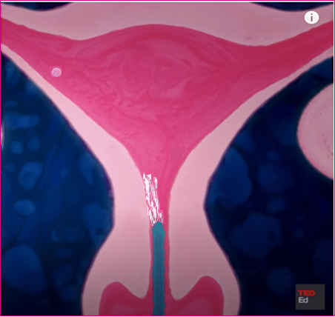
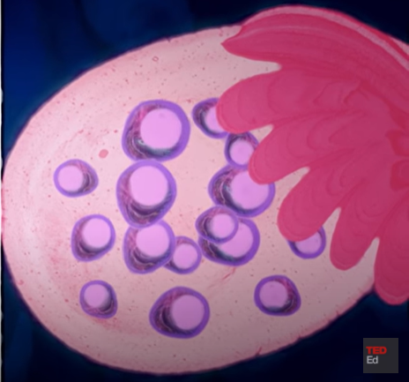
Goal is to stimulate egg production, and monitor in order to maximise success of a single pregnancy.
Injections of FSH given to increase
number of eggs produced.
Ovulation monitored.
Normal fertilisation occurs or
Intra-uterine insemination is used
at time of ovulation.
Read
View
Notes
To Do

Slide 17
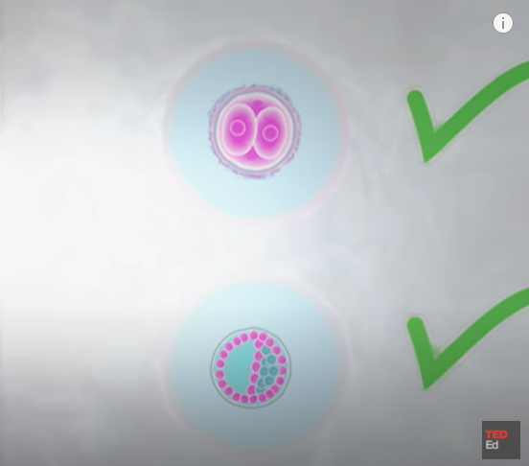

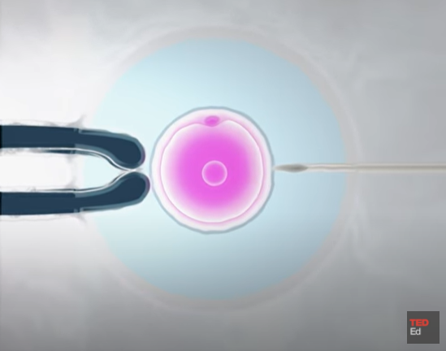
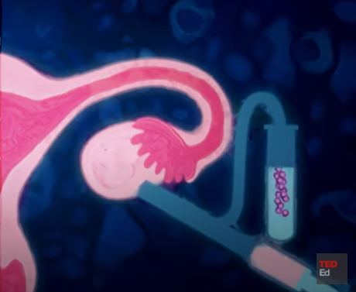
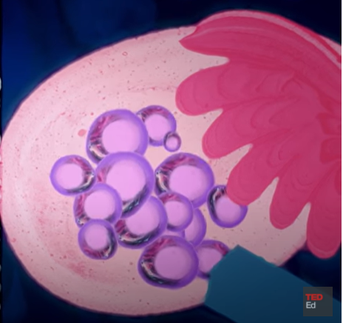
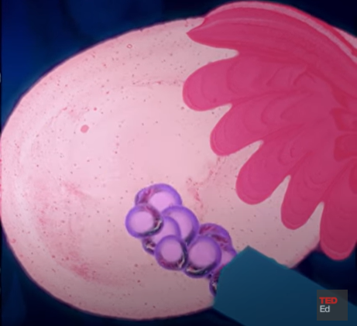
In-vitro fertilisation
Read
Goal is to find the single best embryo in order to maximise success of a single pregnancy.
Egg production is
stimulated.
Eggs are collected.
External fertilisation
occurs.
Embryo is screened.
Embryo is transferred
back into uterus.
View
Notes
To Do

Slide 18
Infertility problems happen on an average to 1 in 8 couples. How would the following affect the ability to conceive a child, and which ART would you recommend?
1. A 39 year old female is trying to conceive and cannot fall pregnant.
3. A 28 year old female has blocked fallopian tubes.
2. A male has a low sperm count.

Slide 19

Infertility problems happen on an average to 1 in 8 couples. How would the following affect the ability to conceive a child, and which ART would you recommend?
1. A 39 year old female is trying to conceive and cannot fall pregnant.
Fertility is greatly decreased with the age of the woman. She may just need ovulation stimulation with injections to increase the number of eggs produced, and monitor when ovulation occurs. At the same time, the male’s sperm would be evaluated for sperm count and mobility. If the latter is good, doctors would let nature take its course, or she might have intra-uterine at the time of ovulation to ensure fertilisation occurs.

Slide 20


Infertility problems happen on an average to 1 in 8 couples. How would the following affect the ability to conceive a child, and which ART would you recommend?
2. A male has a low sperm count.
Fertility can be affected when the number or quality of sperm produced is low. Doctors might observe a sample under a microscope, and recommend external fertilisation or IVF, where a few eggs are produced by an injection of Ovulation Stimulation hormones, and at ovulation, are collected, and fertilised with the male’s sperm. The embryos are then implanted back into the uterus of the female.

Slide 21

Infertility problems happen on an average to 1 in 8 couples. How would the following affect the ability to conceive a child, and which ART would you recommend?
3. A 28 year old female has blocked fallopian tubes.
Blocked fallopian tubes means that the egg which is produced each month cannot travel down the fallopian tubes, nor can the sperm get to the egg. Therefore the egg cannot be fertilised. She would need to undergo IVF (see above answer)

